Slide 1
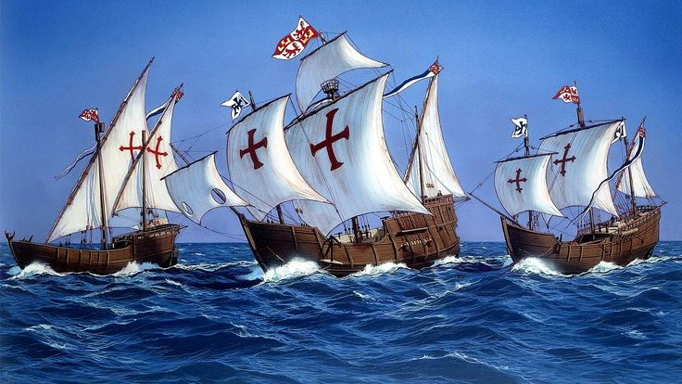
Columbus Reaches
the Americas
7th Grade Social Studies

Slide 2
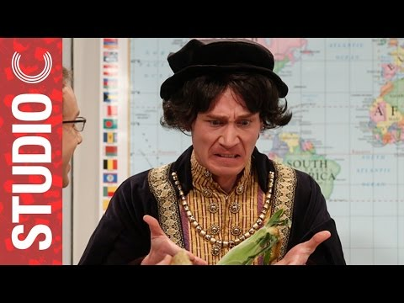
Who was Christopher Columbus?
Christopher Columbus was a navigator and explorer who was born in Italy.
Note: video is intended to be informational and entertaining.

Slide 3
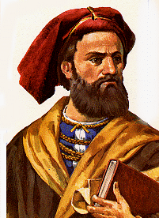
Who inspired Columbus to explore?
He became interested in sailing to the Indies after reading Description of the World written by Marco Polo (pictured right).

Slide 4
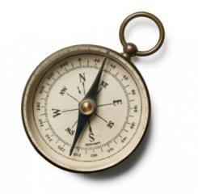
Columbus: Before the Fame
Columbus spent time studying sailing with the Portuguese, who were master sailors at the time.
Columbus sailed the ocean blue from Africa to Iceland with Portuguese ships. This allowed him the opportunity to work on his navigational skills.

Slide 5
¿Hablas español?
Columbus asked the King of Portugal for money but, he was turned down. Columbus wanted to find a direct sea route from Europe to Asia.
Columbus was determined to set sail on his grand adventure. Finally, he was given financial support by Queen Isabella and King Ferdinand of Spain.

Slide 6
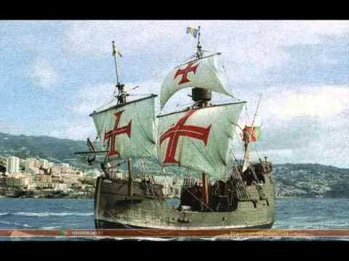
In 1492, Columbus Sailed the Ocean Blue!
On August 3, 1492 Columbus set sail with three small ships, the Santa Maria, the Pinta, and the Nina, and a crew of about 90 men and boys.
The journey was not easy! Columbus’s crew had enough after months at sea. They were going to mutiny and overthrow Columbus. To save himself and his mission, he promised the crew if he did not find land in three days they would return home.

Slide 7
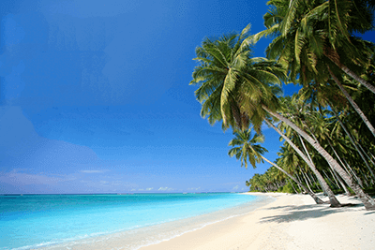
October 12, 1492
Columbus landed in the present-day Bahamas and named the island San Salvador.
He thought he found an island in the Indies. He was wrong.

Slide 8
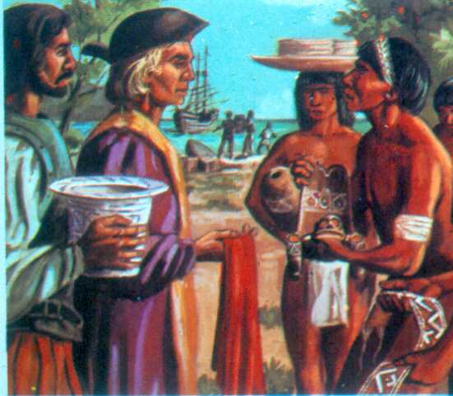
Yoohoo… anyone home??
The island was inhabited by indigenous people known as the Taino. Columbus called the people Indians because he thought he was in the Indies. We will learn more about the Taino later in this unit.

Slide 9
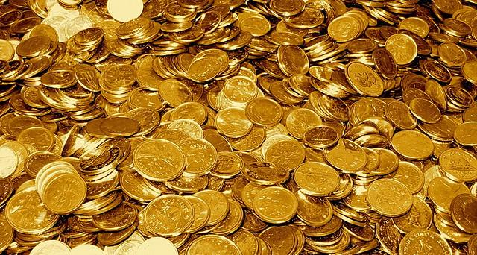
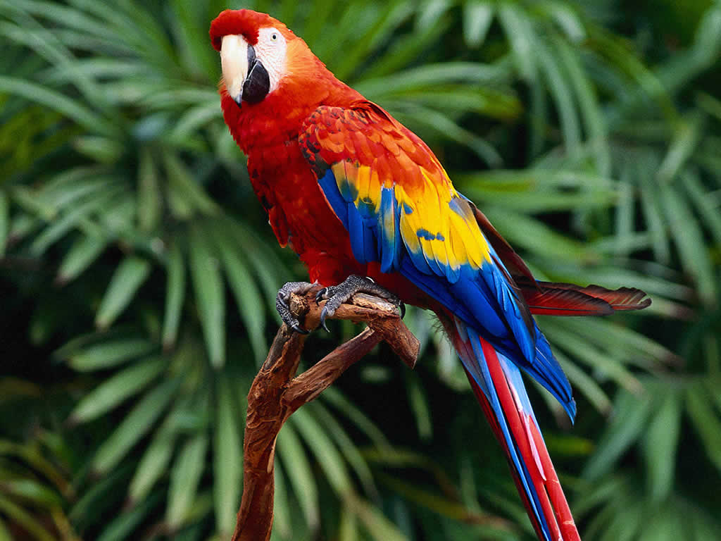
A Hero’s Welcome
Columbus brought back a variety of animals, plants, and some gold from his first voyage to the New World. The King and Queen of Spain were so excited about all the riches Columbus brought back from the “Indies” that they financed 3 more trips (4 in total) for Columbus.

Slide 10
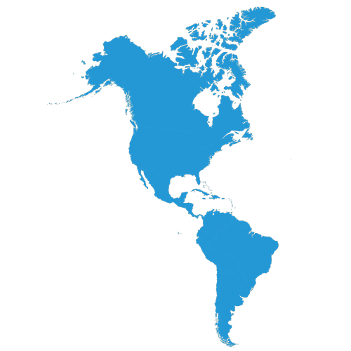
Continued Exploration
Columbus continued to explore. He never realized he actually was in the Americas before he died in 1506. Although, he and others did not realize until later that he did not land on our current continent.
So why aren’t we called the United States of Columbus?? Amerigo Vespucci was one of the first Europeans to realize they were in uncharted territory. He called this land “the New World” in his booklet. A German map maker created a map based off his findings and chose the name America to honor Amerigo Vespucci.

Slide 11
Credits
https://www.youtube.com/watch?v=GD3dgiDreGc
https://www.britannica.com/biography/Christopher-Columbus
https://www.loc.gov/exhibits/exploring-the-early-americas/columbus-and-the-taino.html
https://www.americanjourneys.org/pdf/AJ-062.pdf
http://www.gutenberg.org/cache/epub/20321/pg20321-images.html
https://www.britannica.com/biography/Bartolome-de-Las-Casas
https://www.britannica.com/biography/Joel-Barlow
https://www.smithsonianmag.com/history/alfred-w-crosby-on-the-columbian-exchange-98116477/
https://www.gutenberg.org/files/8683/8683-h/8683-h.htm

